Slide 1
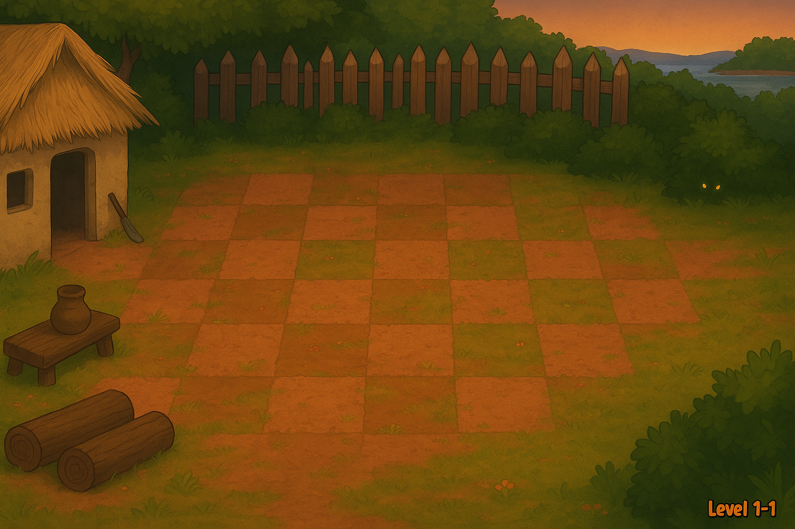

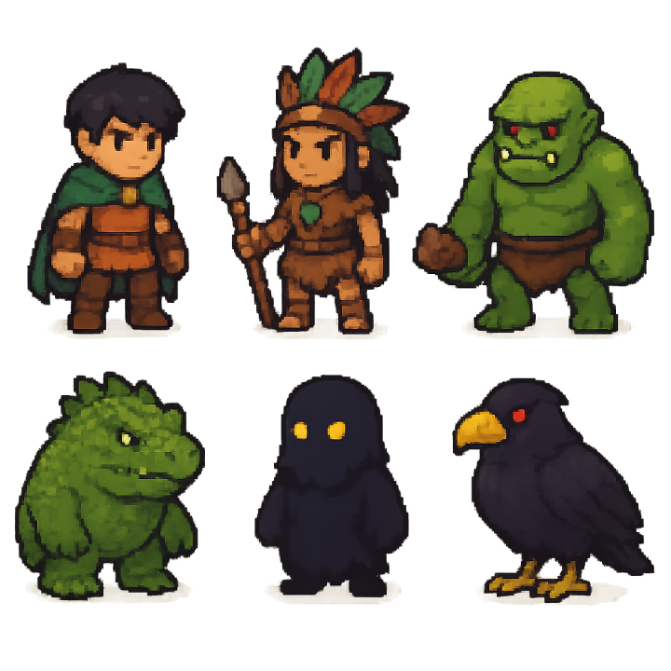

ImageCampus - TP 1 - Gabriel Campo

Slide 2



